Slide 1
2013 Popcorn Kickoff
WELCOME!
Let the Adventures Begin.

Slide 2
Notes:
Show Teresa Barnett Video

Slide 3
2013 Popcorn Sale
Exciting NEW products
Simple steps for growing your sale
Best way to SELL
INCENTIVES that motivate!
One-stop shop at www.trails-end.com

Slide 4
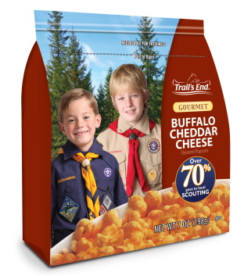
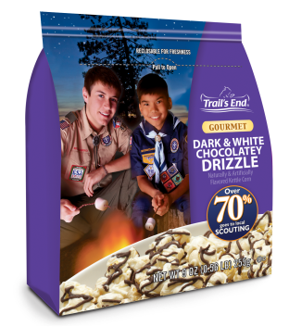
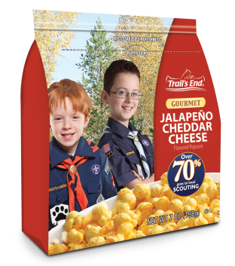
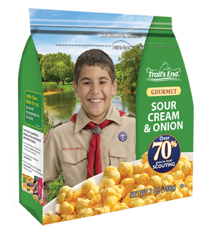
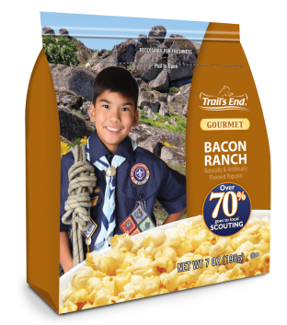
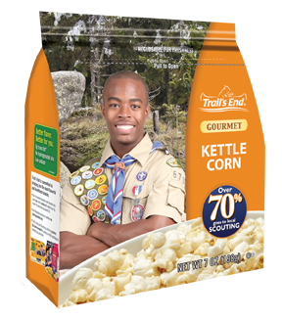
New Products
Buffalo Cheddar
Cheese
Dark & White Chocolatey
Drizzle
Jalapeno Cheddar
Cheese
Sour Cream & Onion
Bacon Ranch
Kettle Corn Pre-Pop
Notes:
Drum Roll Please!

Slide 5
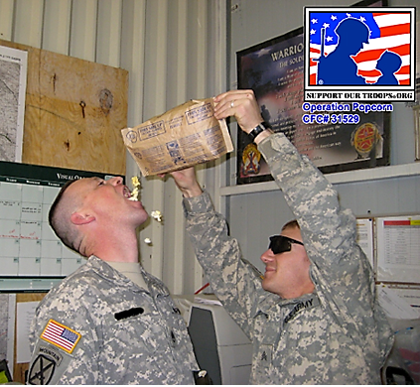
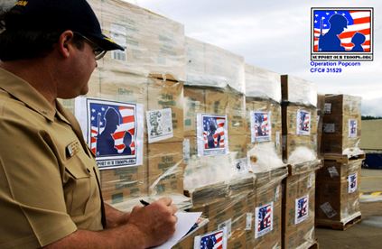
Popcorn For Our Troops
Over 1.3 million donations since 2007
$30 Silver Level Donation
$50 Gold Level Donation
Notes:
Visit trails-end.com for more information about this program.

Slide 6
2013 Product Line
Chocolate Lovers
$50 Military Donation
$30 Military Donation
Sweet & Savory
Cheese Lovers
Caramel Corn with Almonds & Pecans
Dark & White Chocolatey Drizzle
Popping Corn
Unbelievable Butter
Butter Light
Bacon Ranch
Sour Cream & Onion
Jalapeño Cheddar Cheese
Buffalo Cheddar Cheese
Kettle Corn
Caramel Corn
0g trans fat across the entire product line
Notes:
Highlighted in red are all the new products for 2013

Slide 7
2013 Product Line
(Show family guide)
Notes:
Show council’s family guide

Slide 8
One Stop Shop at Trails-End.com
Online Selling
Popcorn System – place popcorn orders
Virtual Sale Planner
Training Videos & Tutorials
Notes:
Everything you need is at trails-end.com

Slide 9
Grow Your Sale
Plan your program and Set Goals
Motivate your Scouts with INCENTIVES!
Build your best Popcorn Kickoff ever!
Constantly Communicate with Scouts and parents
Use the best ways to Sell and achieve your goal!
Notes:
Trail's End has everything your leaders need to plan and execute a successful popcorn sale. Have your leaders review the Popcorn Sale Guidebook (included in each Popcorn Sale Kit Folder) and follow the five steps above.

Slide 10
#1 Plan Your Program
Go to the Virtual Sale Planner at sell.trails-end.com
Build your plan using the Program Planner
Plan
Budget
Set Goals
Fill in your number of boys, commission and activities per month with costs.
The planner does the rest!
Notes:
Ask the crowd – Are you really asking your Scout families to sell popcorn or consumers to buy popcorn? NO! Scouts are selling the Scouting program and consumers are choosing to support that Scout and his program! It all starts with your program plan!

Slide 11
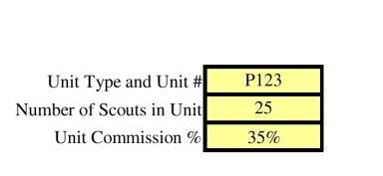
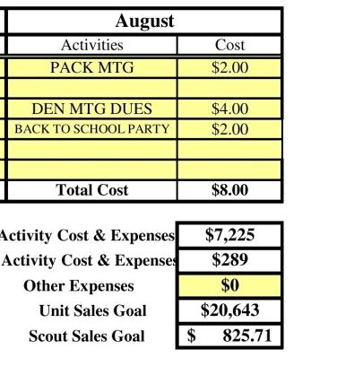
Complete Your Program Planner
Notes:
Use this script to help your Scouts feel comfortable speaking to, and selling popcorn to customers.

Slide 12
Set Your Sales Goal- $600!
Only 44% of parents say their
Scout set a sales goal.
Scouts who set goals average $626 in sales.
Scouts with no goal average $304 in sales.
Notes:
Emphasize the importance of setting a sales goal. Scouts who set a goal sell on average twice as much as Scouts who do not set a goal. The same is true for units.

Slide 13
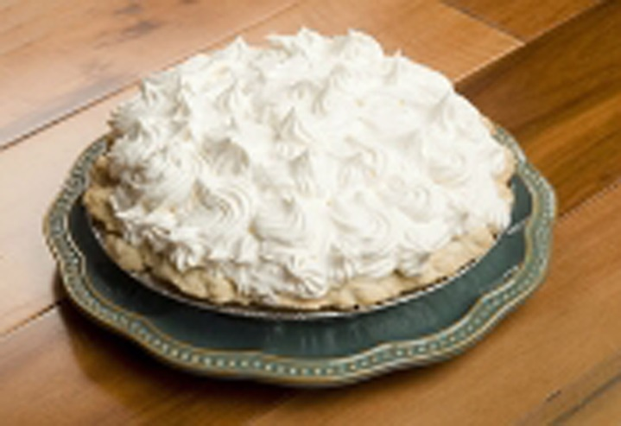
#2 Motivate Your Scouts
Build your own unit-level incentives
Pie in the Face for $600 Sellers!
Top Seller Prizes!
Top-selling Den – Pizza Party!
College Scholarship
Sell $2,500 once and 6% of your total sales each year is invested in your own college scholarship account
Notes:
Stress the importance of units having their own incentives. The Pie in the Face, etc are critical.

Slide 14
#2 Motivate Your Scouts
Council Prize Program – Show Prize Brochure
Notes:
Add in prize program information

Slide 15
#3 Build the BEST Popcorn Kickoff!
The kickoff is the single most important factor for
you to have a good sale
Have a 30-minute fun-filled Popcorn Kickoff:
Make it FUN and FESTIVE!
Show parents what’s in it for them
Have giveaways and prizes
Prepare your Scouts
Have role plays and practice the sales script
Help your Scouts gain the confidence to sell!

Slide 16
#3 Build the BEST Popcorn Kickoff!
Kickoff Tools for You
Refer to the Popcorn Sale Guidebook
Customize the Kickoff Presentation in the Virtual Sale Planner
Training videos from trails-end.com
Invest a little in your kickoff to reap huge rewards with your sale!

Slide 17
#3 Build the BEST Popcorn Kickoff!
Want to close sales? Take the following approach when
speaking to a potential customer…
Hi, my name is _____ and I’m a C/B scout w/ P/T # ___.
I’m selling popcorn so I can ______.
(go to camp / pay for my scouting program / earn a scholarship)
I have a goal of $____.
You can help me reach my goal by trying some of my popcorn!
Will you help me?
More effective than asking, “Want to buy some popcorn?” don’t you think?

Slide 18
Notes:
Show Better Kickoffs Video

Slide 19
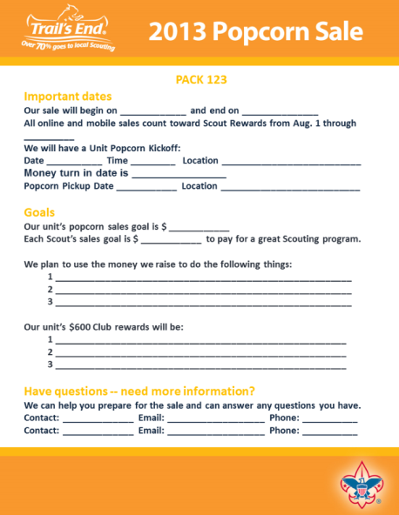
#4 Communicate with your Families
It’s important to follow up after your kickoff and throughout the sale with important sale information.
Use email, social media, and meetings to remind families about:
Sales goal for each Scout
Key sale dates
Scout rewards available
Online selling
Go to trails-end.com to access communication tools:
Promotional Images
Scout and parent handouts
Notes:
Review the leader guide that is to be handed out.

Slide 20
#5 Best Ways To Sell
$600 is the GOAL
Invest a little time with your son and achieve your Goal!
TAKE ORDER = $400 Goal
Average $200 per hour Door-to-Door = 2 hours
SHOW & SELL = $100 Goal = 1 hour
ONLINE = Every Scout emails 10 family or friends = 10 minutes

Slide 21
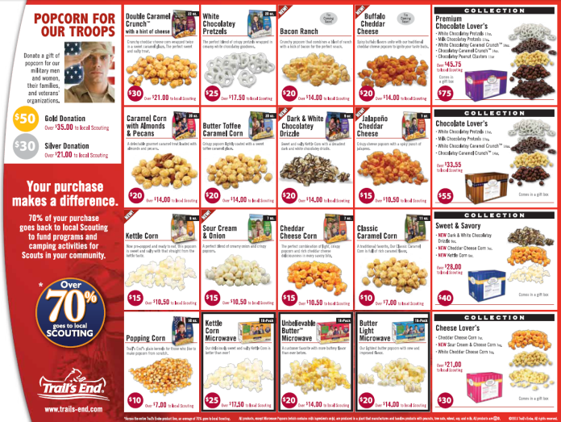
Take Order
Scouts use an order form (in the family guide)
to go door-to-door or sell to family and friends.
Establish your dates – take order sales typically start immediately after kickoff.
Determine sales territory
Create a “Blitz Day” to have Dens sell as a group activity
Have parent(s) take an order form to work
REMEMBER!
Two out of three people will buy when asked,
but less than 20% of households have been contacted.
Notes:
Advantage: Higher dollar sales per customer and more product sold by Scouts. Use any product left over from Show-n-Sell to fulfill need. Only order what you have sold.

Slide 22
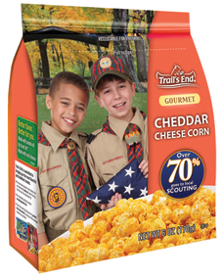
Show & Sell
Make arrangements for Scouts to set up in front of stores to sell.
Ask store manager for permission several weeks in advance
Assign Scouts (2-3) and parents in two hour blocks
DO NOT open up microwave boxes
Divide sales equally among Scouts who participate
Use leftover product to fulfill take order needs
Apply donations received towards your military sales
Notes:
Advantage: Selling in a group with leaders is a good training ground for Scouts. Typically, lower priced items sell better during show & sells.

Slide 23
Show & Sell
Who would like to present some key action items that helped their unit achieve success last year?
Notes:
Use a volunteer to present a show & sell success story

Slide 24
Online Selling
Scouts sell to far-away friends and family Trail’s End ships the product directly to the consumer.
Everyone needs to create a new account to view and sell online at sell.trails-end.com
Online sales COUNT toward Scout Rewards! (starting August 1 through your council’s fall sale end date)
Get 100% of your Scouts to create an account and send 10 emails to family and friends
The average online order is $48
Notes:
Online selling is a great way to reach far away friends and family. With the brand new trails-end.com, all Scouts & leaders will need to create a new account at sell.trails-end.com.

Slide 25
Notes:
Show Scout Training Video

Slide 26
Next Steps
Plan your program and Set Goals
Motivate your Scouts with INCENTIVES!
Build your best Popcorn Kickoff ever!
Constantly Communicate with Scouts and parents
Use the best ways to Sell and achieve your goal!

Slide 27
Key Dates
8/23 | Show and Deliver Orders Due
9/11 | Show and Deliver Popcorn Pickup
9/11 | Popcorn Sales Begin
9/13-15 | Fry's Store Sales
9/20-21 | Safeway Store Sales
9/27-28 | Safeway Store Sales
10/4-5 | Fry's Store Sales
10/23-25 | Show and Deliver Returned to Council**
10/25 | Take Order Popcorn Orders Due
11/13 | Units Pickup Popcorn for Delivery
12/4-6 | Popcorn Settlement**
Notes:
Customize for the council – Add Key Dates

Slide 28
What’s in it for YOU!
Leader Kit
Product Samples
Bonus commission for attending
Who is going to GROW THEIR SALE!!!
Notes:
Customize for the council and build up the excitement on this slide!

Slide 29
Thank You!
Facebook.com/trailsendpopcorn
©2013 Trail’s End®. All rights reserved.

