Slide 1
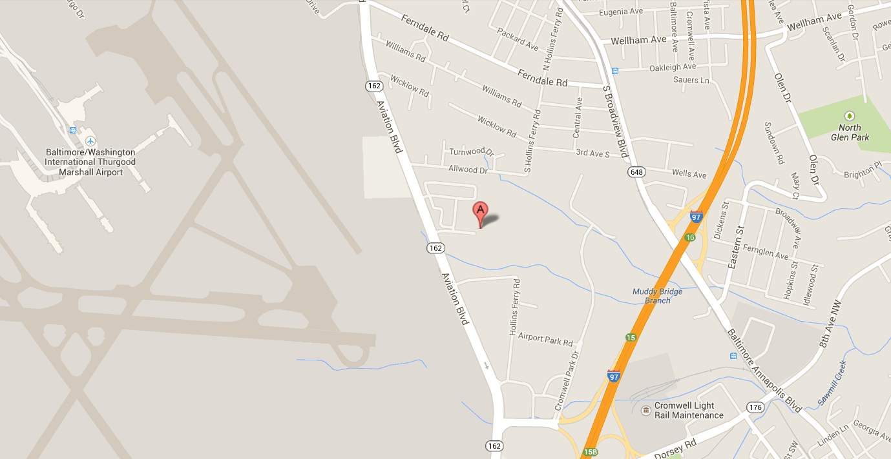
Scouting for Food
Bag Drop-off
to neighborhood homes on
Saturday, March 29, 2014
Don’t know what neighborhood to cover?
Contact Denise Bach 410-674-3182 redhairbach@verizon.net
Donation pick-up: Saturday, April 5, 2014
Units drop off collected donations between 9 AM – 2 PM
at
J.J. Haines Co. Warehouse
6950 Aviation Blvd, Glen Burnie
JJ Haines Warehouse
--- HELP NEEDED ---
Scout Units needed to help with collection intake, sorting, and packing
8:30 AM – 2:30 PM at J.J. Haines Warehouse on April 5.
Earn Service Hours for Scouts and School.
You provide adult-supervised Scoutpower. We provide breakfast snacks, drinks and lunch.
Contact Jim Krempel 410-551-9889 EwokScout@verizon.net

