Slide 1
Get excited about 2014!
atlantabsa.org/popcorn
Atlanta Area Council, Atlanta, Georgia
©2014 Trail’s End®. All rights reserved.

Slide 2
Why Sell Popcorn
Raises money to fund program.
Other organizations stop there.
Here are 7 more SCOUT reasons.
Scouts experience adult interaction.
Character building.
Scouts are responsible for own program.
Incentives (prizes, $$, etc.)
Scholarship Fund.
Easy and profitable compared to other fund raisers.
Cub Scouts (now Boy Scouts) might be really good at it.

Slide 3
New Kernel Training
After Saturday August 2nd & 9th Kickoffs
or Webinar Aug 12

Slide 4
Tips on Selling Methods
4 Keys to Success
Recruiting team members
New for 2014
2014
Atlanta
Area
Unit
Trainings

Slide 5
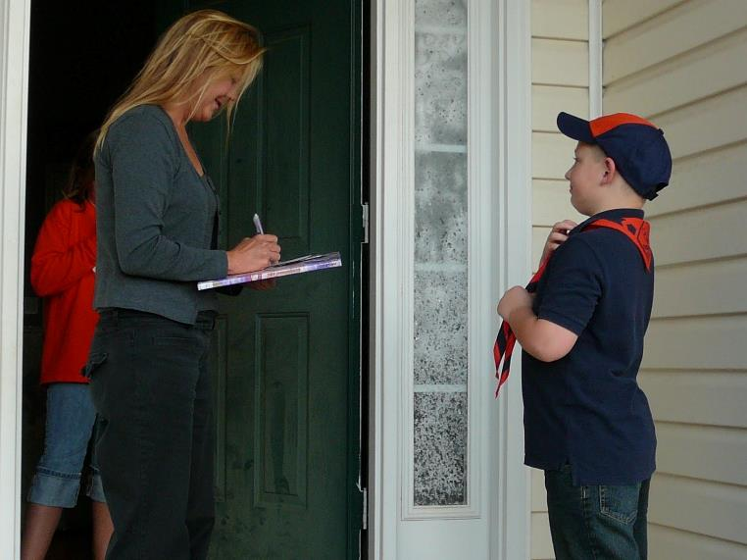
Sales Method #1 Take Order

Slide 6
Successful Take Order
Generates most sales
Always wear your ________?
(right! uniform)

Slide 7
Successful Take Order
1. Take Order Ideas
Have a neighborhood “Blitz Day”. Whole pack or troop covers one neighborhood. “Secret house” prize.
Show N Deliver. Take popcorn to the door.
Practice a “script”. Simple and personal.
Focus on Scouting “We’re not selling popcorn, we’re selling ________?
Use donations for Support the Troops
Always wear your _____________? (did you say “uniform”?)

Slide 8
Successful Take Order
2. Tips from the “experts”
Set “time goals” or “neighborhood goals”
Write down your goals and why they are important
Plan out neighborhood routes
Neighborhood sales tracking sheet
Call on businesses. Businesses do buy popcorn for their employees.
Turn a “no” into a $5 YES

Slide 9
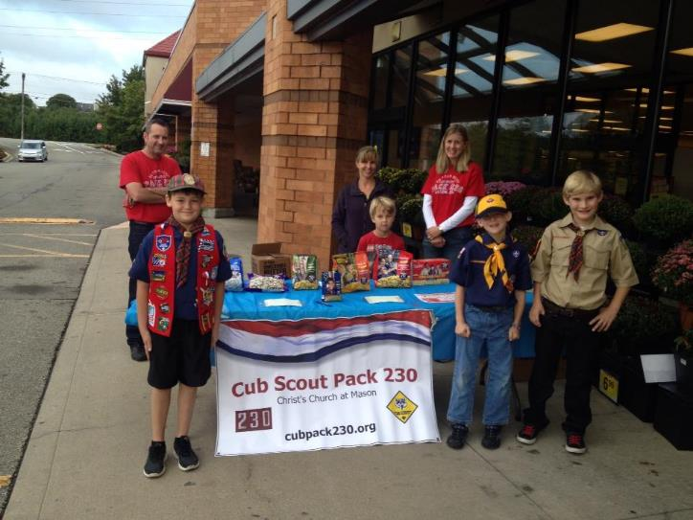
Sales Method #2 Show N Sell
MO

Slide 10
Successful Show N Sells
SnS Prep
Best location: high traffic areas
Secure SnS sites early ... now!
Secure 2+ for each den/patrol. Have them sign up!
Always wear uniform. (but you already knew that.)

Slide 11
Successful Show N Sells
2. SnS Sales Days
Make it fun: grilling, costumes, music, etc.
2-4 boys per 2 hr. shift
Keep Scouts Engaged: no sitting / staying behind table
Be specific with customers on what fundraising is for. Focus on Scouting. (Camping, Space Camp, etc.)
Display banners / make signs
Have Scouts practice
DO NOT break open the microwave boxes Why? a) not labeled for individual resale, b) have to make 18 x $1 sales instead of 1 x $18 sale. people will almost always give the smallest amount.

Slide 12
Successful Show N Sells
3. Selling Ideas
Credit Card Readers. These work well. Try getting a credit card sale as a last resort.
No-Show N Sell: Military Donations Have no product. Just collect money to buy Military Popcorn. Everyone likes to help both Scouts and the Military!
Snow-N-Sell to Police / Fire Station Take donated money and buy popcorn. Take it straight to Police or Fire Station. Take pictures. Repeat.
Show-N-Sell-N-Deliver: Hub approach Have Show-N-Sell but with extra stock. While some scouts sell at store, rest of Scouts canvas nearby neighborhoods with Show-N-Deliver and restock from store’s sale.

Slide 13
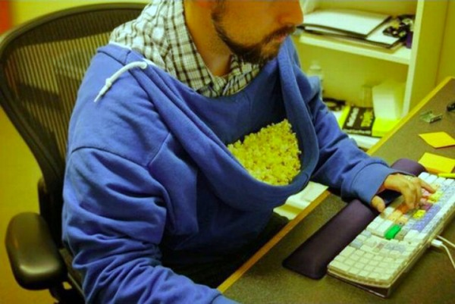
Sales Method #3 Online Sales

Slide 14
Successful Online Sales
1. Online Updates
Begin selling on August 1
All products will be available
Prices may be different (each council chooses their prizes so online sales are national average.)
Single Items & Flat Rate ($7 or $8/Microwave)
Chocolate sales when weather permits (won’t ship when temp above 80°to prevent melting)
Setting up accounts has been improved
As always, sales count toward prizes

Slide 15
Successful Online Sales
2. Tips for selling
Customize emails to friends and family
Great method for Troops/Crews

Slide 16
Successful Sale
Popcorn sales does work.
Popcorn sales is easy.
Popcorn sales is profitable.

Slide 17
Successful Sale
#1: Goal Setting

Slide 18
Goal Setting
The first Step to Success is setting a goal: both for your unit and for the Scouts.
Average sales were 170% higher among Scouts who set a sales goal
Average sales were 89% higher among Units who set a sales goal

Slide 19
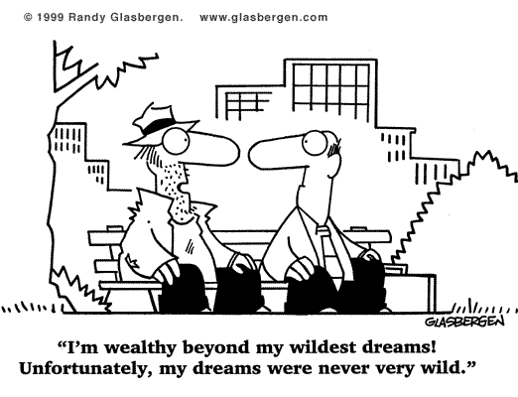

Slide 20
Goal Setting
What is your unit’s “Wildest Dreams.” One unit in Alaska decided they wanted to go to summer camp ... in Hawaii. Leaders figured it would take $90,000 in popcorn sales to cover it.
They did it!
What is your Ideal Year of Scouting?

Slide 21
Ideal Year of Scouting
What makes Scouting great? What’s your Ideal Year? Dream it. This is Scouting!
Philmont
Sea Base
Pinewood Derby
Awesome Blue and Gold
Camping in Colorado
Aircraft Carrier Yorktown
Battleship Alabama
Space Camp
Sapelo Island
Cave Camping
Kayaking
Whitewater Rafting
Northern Tier
Tour Washington D.C.
Grand Canyon
Hawaii Scout Camp

Slide 22
2010 Consumer Spending
Program Planner
This spreadsheet will be available on your thumb drive and the web to help you plan your year.
Enter all activities and per scout costs for your unit for the next 12 months; Enter the number of scouts in your unit; Enter your unit commission % to be earned in the popcorn sale; Your unit's and each scout's popcorn sales goal will calculate automatically. *Note...fill in the shaded boxes only. |  |  |  | Pack/Troop | 0
 |  |  |  | # of Scouts in Unit | 0
 |  |  |  | Unit Commission | 0%
September |  | October |  | November
Activities | Cost | Activities | Cost | Activities | Cost
Total Cost | $0.00 | Total Cost | $0.00 | Total Cost | $0.00
December |  | January |  | February
Activities | Cost | Activities | Cost | Activities | Cost
Total Cost | $0.00 | Total Cost | $0.00 | Total Cost | $0.00
March |  | April |  | May
Activities | Cost | Activities | Cost | Activities | Cost
Total Cost | $0.00 | Total Cost | $0.00 | Total Cost | $0.00

Slide 23
Goal Setting
Ugh ... Math ... But Easy ... How to figure up how much popcorn to sell.
Calculate $$ of an “Ideal Year of Scouting” (Ask Committee for Budget - JtE)
Determine how much popcorn to sell
Calculate dollar goal per Scout
Break the goal down to a container goal
$19.00 (avg. retail per container)

Slide 24
Calculating Sales Goal
$2,800
/
35%
=
$8,000
Budget Goal
Unit Commission
Sales Needed
Enter #
of Scouts
$8,000
/
25
=
$320
Sales Needed
# of Scouts
Scout’s Goal
$320
/
$19.00
=
17
Scout’s Goal
Avg. Price per Container
Container Goal

Slide 25
Remember this?
Average sales were 170% higher among Scouts who set a sales goal
Scouts see INCENTIVES as their goal.
So what are some good UNIT incentives?

Slide 26
Unit Incentives
Encourage your Unit to do the following …
Door prizes during the kick-off QUANTITY not quality!
Parties (pizza or sundaes) for the top sellers
Extra incentive to Scouts who hit their goal
Prize for top seller in Pack or Troop such as... Gift cards iTunes card GameStop Fishing pole Back pack Scout shop gift Certificate What Else
And of course the ever popular …

Slide 27
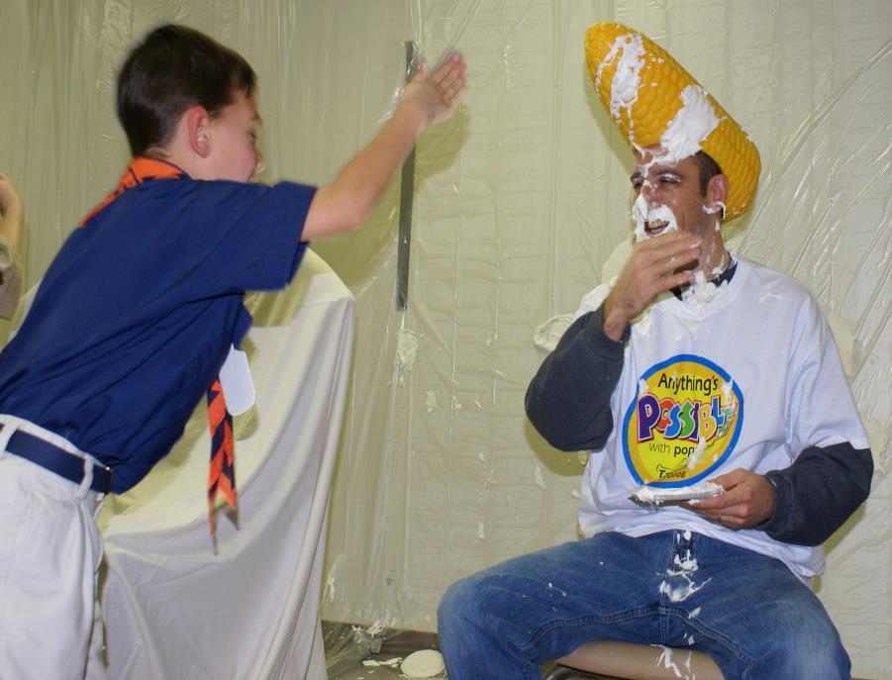
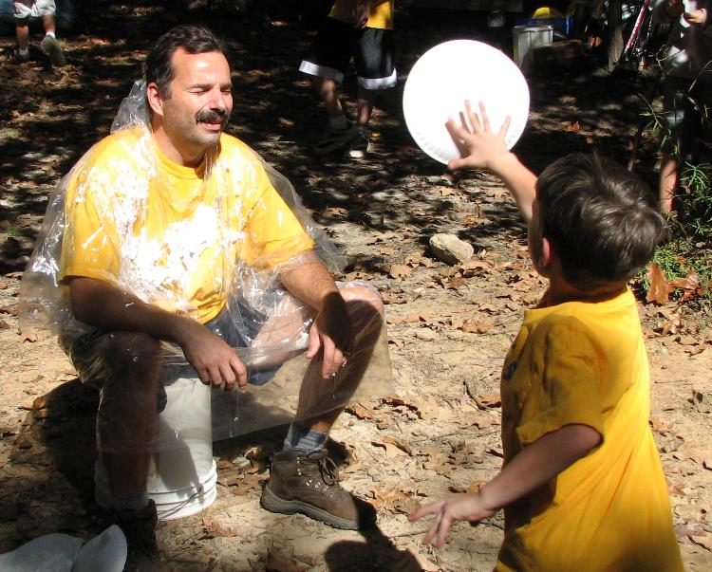
Pie In The Face

Slide 28
Goal Setting Review
Every unit needs a sales goal!
Break down goals to “per Scout” or “per family”
Tie it to your program! This ensures success!

Slide 29
Successful Sale
#2: You
Seriously. We’re serious about this one.

Slide 30
The Unit Popcorn Kernel
Sale is determined MORE by the Unit Popcorn Kernel than anything else.
YOU will have a major impact
YOU will create the excitement
YOU will determine participation rate
YOU will influence the profit.

Slide 31
The Unit Popcorn Kernel
Regular Communication is key ….
Have Weekly updates.
Have Weekly (Troop meetings) or Monthly (Pack meetings) prizes.
Packs: have a den parent that keeps you updated.
Share best practices at den, pack or troop meetings
Keep information in front of the parents
Stay excited ... or find someone who can.

Slide 32
Successful Sale
#3: Kickoff
MO

Slide 33
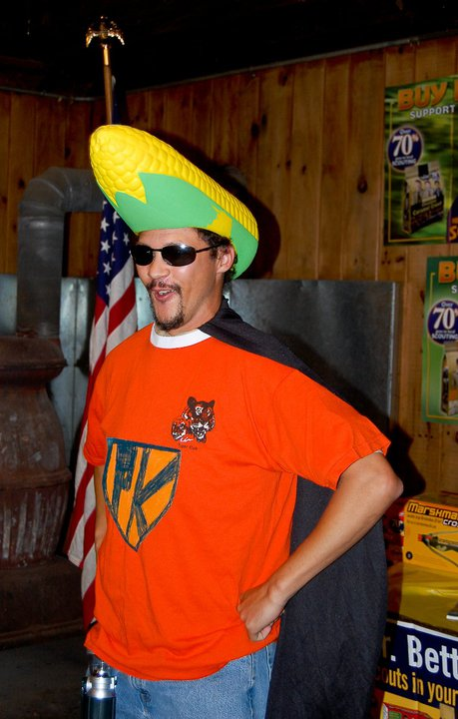
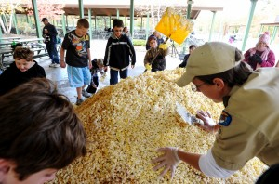
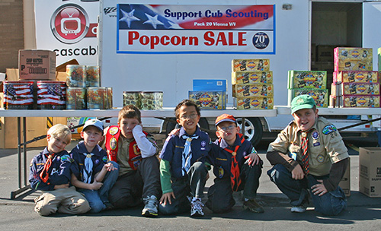
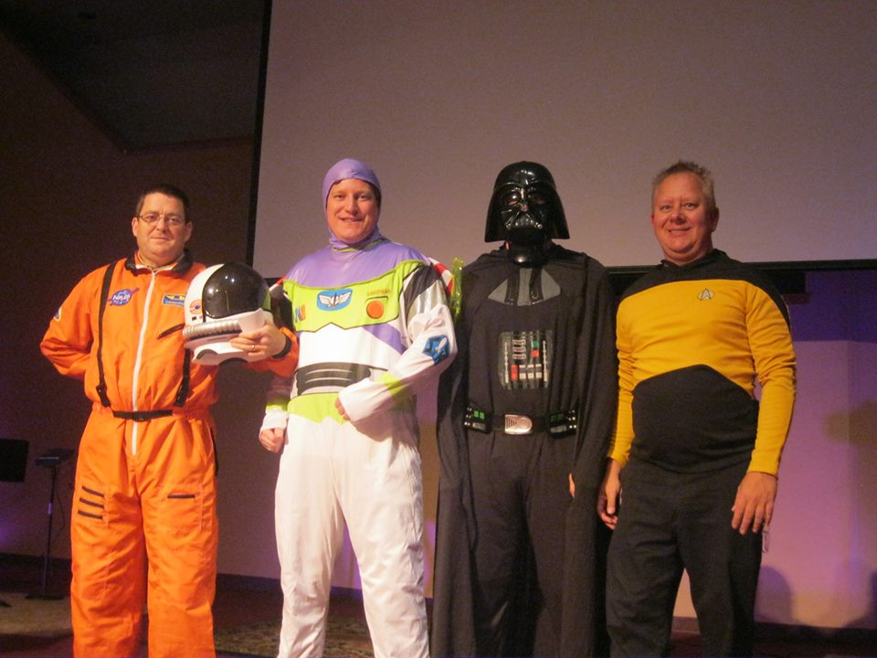
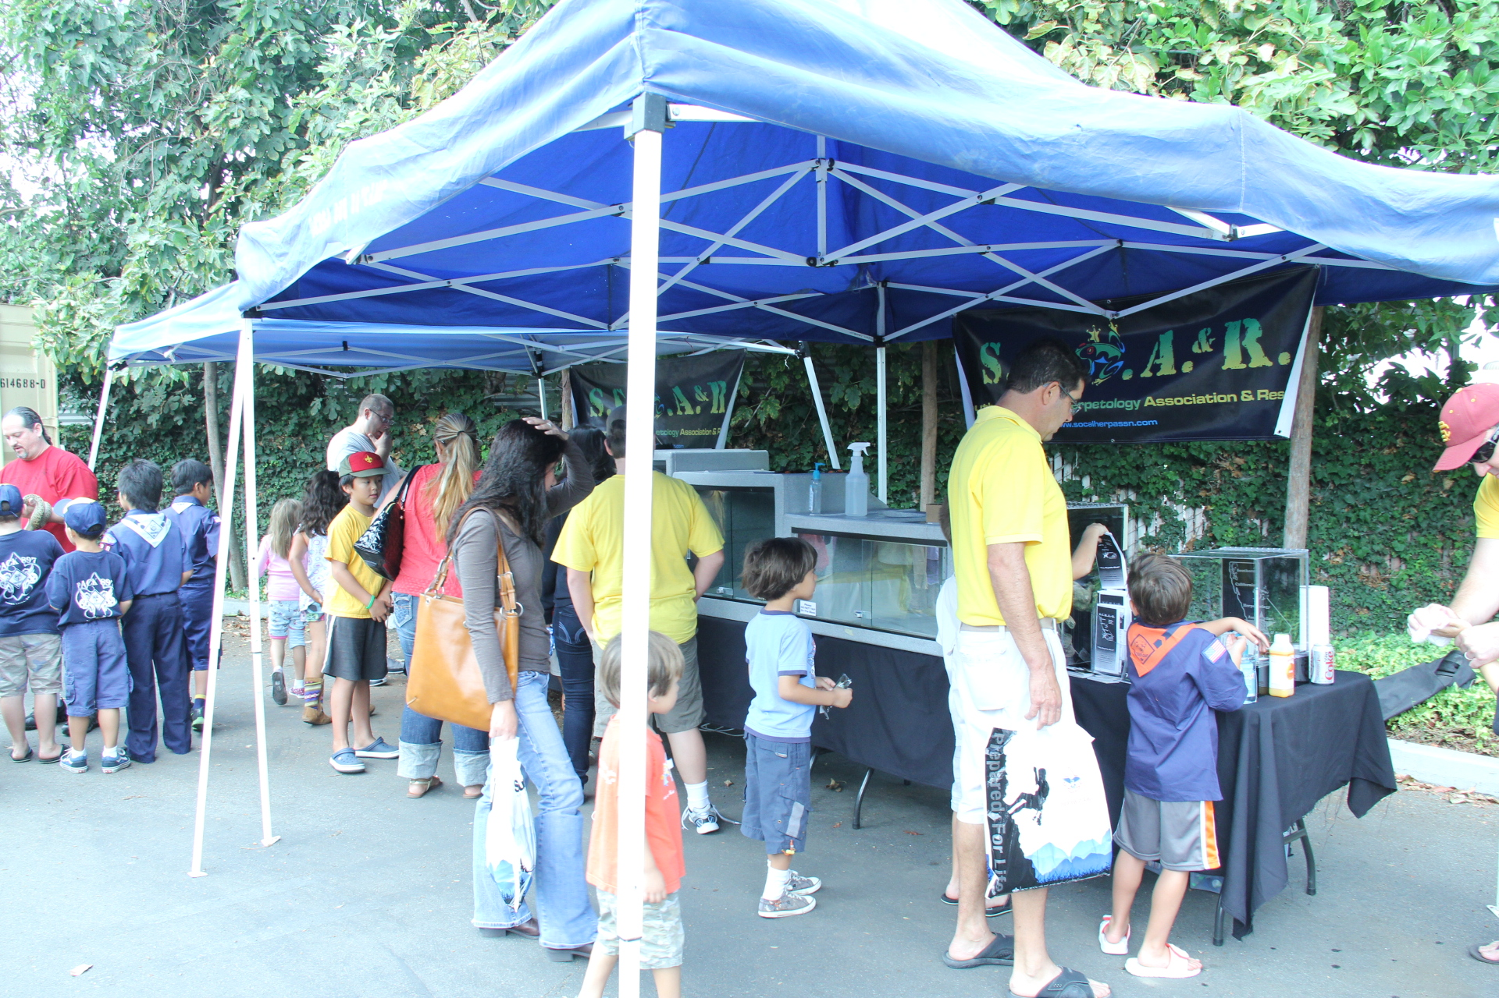
Host a GREAT Unit
Kick-Off!

Slide 34
Successful Kick Off
Ideas for Fun ...
Door Prizes: Spend $100 to make $10,000. quantity over quality.
Decorations, costumes, etc. (even for Boy Scouts)
Have popcorn to eat, Popcorn machine. Stink up the room!
Fun skits
Games: stations, guess the # of popcorn in the jar, contests, etc.
Practice bad and good delivery
Get the Scouts INVOLVED.
You’re creating MOMENTUM (more on that later)

Slide 35
Successful Kick Off
Fun, Exciting, Motivating
Be Creative, Have a Theme: Mission Impossible, Sci-Fi, Country & Western, what else?
Scouts & Parents should know everything when they leave
Explain the sale & benefits
Training Scouts: Salesmanship & Safety
Remember first time Scouts and parents
Will learn what this is for, and how to do it
Parents need to understand “What’s in it for me” (have hand outs—next slide)

Slide 36
Parents: “What’s in it for Me”
Create incentives that will draw in parents ... like yourself!
Local business freebies
Dues returned
Trips / events paid for
What else?
What to say to parents ...
“Sell $$$, and keep checkbook closed.”
“Sell $$$, Scout learns to “earn their own way”
“Sell $$$, unit has the funds to execute a fun-filled Scouting program!”
“Scout learns life-lessons: self reliance, communication, perseverance, etc.”

Slide 37
Kick Off
Train Scouts on Salesmanship: Good, Bad & Ugly
Actually have a “skit” where an adult acts out an “ugly” sale (have scouts critique), a “bad” sale (getting better but still not great) and a “good” sale. Sample Script below.
Hi. My name is _______________. (first name only)
I’m a Cub/Boy Scout with Pack/Troop ______.
We’re selling popcorn to raise money for our Pack/Troop to sleep on an aircraft carrier.
You can support us by buying some of our delicious popcorn. (hand customer Take Order form and a pen)
Will you help me?

Slide 38
Just a little silly song you could have your parents sing. Have them take out their wallets and do it!
Popcorn Pokey
(to the tune of The Hokey Pokey)
You put your wallet in.
You put your wallet out.
You put your wallet in and you shake it all about.
You sell some scouting popcorn and your wallet's put away.
That's what it's all about!

Slide 39
Successful Sale
#4: Momentum

Slide 40
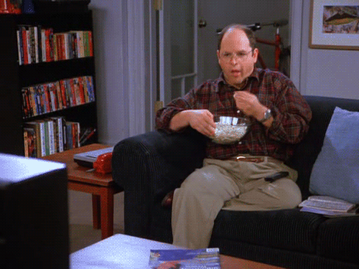
Momentum:
noun: ²the strength or force that allows something to continue or to grow stronger or faster as time passes
Goal + Kickoff + You = Momentum
If you run this slide, animated GIF George has momentum and can’t stop eating popcorn.

Slide 41
Momentum:
So it will be up to you to keep the momentum going.
If you just have a kick-off or hand out the sales packets and don’t do anything else, Scouts will give up. Keep the ball moving. Be Germany in the World Cup and not Brazil! ☺
The following will help keep momentum.

Slide 42
Momentum Ideas
Try and track weekly updates: Den Parent, Scouts bring in sales sheet, etc. Have a weekly incentive or competition
Create weekly email updates to families. Especially incentive reminders.
Create a friendly, competitive atmosphere

Slide 43
Successful Sale Recap
Have UNIT and SCOUT sales goals from Ideal Year of Scouting Budget
Have a great kick-offs with value to families
Have lots of unit incentives
Keep momentum and communication going.
Stay positive and energetic.

Slide 44
Unit Tools
©2014 Trail’s End®. All rights reserved.

Slide 45
2010 Consumer Spending
Unit Potential Sheet
Enter the TOTAL number of scouts in your unit; then your unit's true sales potential and NET commission will populate automatically based on your council's actual sales data. *Note...fill in the GREEN shaded boxes only. |  |  |  | Pack/Troop | Pack 100
 |  |  |  | # of Scouts | 50
AVERAGE UNIT COMMISSION |  |  |  |  | 35%
COUNCIL PER SCOUT SELLING AVERAGE |  |  |  |  | $250
GROSS SALES POTENTIAL* |  |  |  |  | $12,500
* based on every Scout in your unit selling at the council's 2013 per Scout average
NET COMMISSION POTENTIAL* |  |  |  |  | $4,375
* based on every Scout in your unit selling at the council's 2013 per Scout average
What kind of Scouting program could you provide your Scouts and parents with
$4,375
in net dollars to your Pack or Troop?!
DREAM BIG! The opportunity to improve your Scouting program is here!
List the fun Scouting activities your boys want to next year HERE!
1. _________________________________________________________________________________________________________
2. _________________________________________________________________________________________________________
3. _________________________________________________________________________________________________________
4. _________________________________________________________________________________________________________
This will be available for your committee and you to figure out how much popcorn to sell.

Slide 46
2010 Consumer Spending
Thumb drive to Unit Kernels
Training videos Position description sheet
FAQ’s Scholarship form
Popcorn system login Kickoff PPT
Online system login Scout incentive sheet
Creating online Parent information sheet
accounts for Scouts Show N Sell tally form
IYOS spreadsheet Unit sales history (3 yrs.)
Unit potential sheet Family Guide PDF
Sample unit incentives Prize form
Scout sales script Sky rocket PDF
Popcorn info sheet Den goal setting poster
New Kernel Kickoff PPT
Every unit gets on at the Council Kickoff

Slide 47
Recruit! Recruit!
©2014 Trail’s End®. All rights reserved.
MM

Slide 48
Recruit
The Unit Kernel shouldn’t do it all.
The hardest part about selling popcorn is the kernel who tries to do it all. You need help. But getting help is sometimes difficult. So when recruiting remember these two things:
Ask Directly: emails never work. Ask people directly in-person or over the phone.
Be Specific: people will volunteer for “tasks” more easily than “titles”. For example, ask someone to pick up Show-N-Sell popcorn instead of asking them to be the Pick-Up Lieutenant Kernel. Or ask someone to decorate and set up for the Kick-Off Party instead of asking them to “Chair the Kick-Off Party Committee.” “Tasks” before “Titles”.

Slide 49
Recruit
Here are some areas you could recruit to help.
Recruit Popcorn Captains
Kickoff
Distribution Pickup
Show N Sell
Communication
Marketing
Business Incentives Procurer
Popcorn Chief (Youth Position)

Slide 50
2014 Improvements
©2014 Trail’s End®. All rights reserved.

Slide 51
2010 Consumer Spending
Key Improvements in 2014
Communication
Regular Newsletter information to Unit Kernels for themselves and to pass on to parents.
Take Order ordering
Order Containers for Take Order!!!!!
Have little or no overages, i.e. extra popcorn!

Slide 52
2010 Consumer Spending
Key Improvements in 2014
New Prizes / Incentives
$1,000 sellers get a $25 camp voucher
For Day Camp or Summer Camp in AAC.
Only 1 per Scout, i.e. no multiples
Gift Cards: Walmart & Scout Shop
Scout Shop will be higher value.

Slide 53
2010 Consumer Spending
Key Improvements in 2014
New Prizes / Incentives
Unit Commission
30% Base commission
35%
New Attend June/July Unit Training (already over)
Attend an August Kickoff
New Email picture of Kickoff to Emily
New Pick up SnS & Take Order popcorn on time
Pay by Deadline, Dec 4
38%
All the above PLUS increase sale 10%
If you didn’t sell any last year and sell at least 1 this year, then you’ve increased by over 10%!

Slide 54
Key Dates
VIP/Champion Dinner
July 21st
Council Kickoffs
August 2nd, 6th and 9th
New Kernel Training
After 2 & 9 Kickoffs and Webinar Aug 12

Slide 55
2010 Consumer Spending
June-July Objectives
Continue to build your Unit Teams
Set up your Show N Sell sites
Select Kickoff date. Put it on calendar. Prepare for it.
Email parents about the upcoming popcorn sale
Unit’s Kick Off date
Benefits / Incentives
Share the “it’s not popcorn, it’s scouting” reasons. Create excitement!

Slide 56
Thank You!
©2014 Trail’s End®. All rights reserved.

